Slide 1
Are you Prepared?
Pablo Rodriguez Vice President
PRTLD
March 10, 2018

Slide 3
Climate Change
Greenhouse effect – Increased concentrations of carbon dioxide CO₂ in the atmosphere trap the Sun’s energy.
Oceans absorb a lot of the CO₂ as a result making it more acidic, negatively affecting marine ecosystems and increasing in temperature.
High atmospheric and ocean surface temperatures are core factors for the increased development of category 4 and 5 hurricanes.
https://www.gfdl.noaa.gov/global-warming-and-hurricanes/

Slide 5
Hurricane Maria
2017

Slide 6
.pr had two colocations; One with Critical Hub and the other in a bunker with AT&T..
Having Any Cast helped because it maintain the DNS redundant at a global and local level.
We never lost our DNS
How did PRTLD continue to be Operational
During and After Hurricane Maria?

Slide 7
Loss of Power and Telecommunication Towers…
“Hasta el 26 de septiembre, el 95% de la isla no tenía electricidad, menos de la mitad de la población tenía agua corriente y el 95% de la isla no tenía servicio de telefonía
celular e internet.”
Comparación del sistema eléctrico de Puerto Rico antes y después del Huracán María - Imágenes tomadas por la NASA desde el espacio

Slide 8
-----⁻

Slide 12
We MUST
Understand that….
The Latin American and Caribbean Regions are highly vulnerable to natural disasters. (e.g.: Earthquakes, tsunamis and hurricanes)

Slide 13
I

Slide 14
Lessons learned from the Earthquake & Tsunami (Japan 2011)
On March 11, 2011, a magnitude-9 earthquake shook northeastern Japan, unleashing a savage tsunami.
The unexpected disaster was neither the largest nor the deadliest earthquake and tsunami to strike this century
This was the first time that as a registry we encounter that our customers require special attention to protect their cyber real estate.
Our Japanese registrars were uncommunicated; consequently, we were forced to extend the renewal dates to protect the end users cyber real estate.

Slide 15
Process of Renewal
As part of our process to renew these name was performing a search in our database of all domain names who's country was Puerto Rico or any other known territory (Antigua and Barbuda, Saint Martin, US Virgin Island) that were affected by the pass of Hurricanes Irma and/or Maria.

Slide 16
Protecting Customers
Cyber Real Estate
The statistics of how many domains we renewed were about approximately of 626 domains. We had first and second level domains (.pr, .com.pr, isla.pr, org.pr, etc.) There were no renewal fees, and the date was extended to Feb 1st.

Slide 17
NEXT STEPS…
It is important that registries operators are aware that their users could be uncommunicated during and after the occurrence of disasters. Consequently, new policies should be instituted to ensure the protection of their cyber real estate.

Slide 18
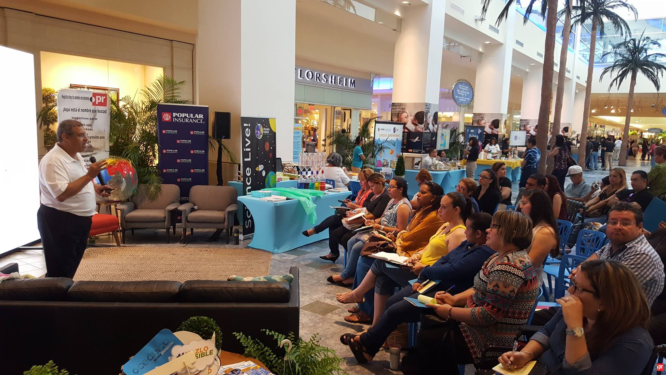

Slide 19
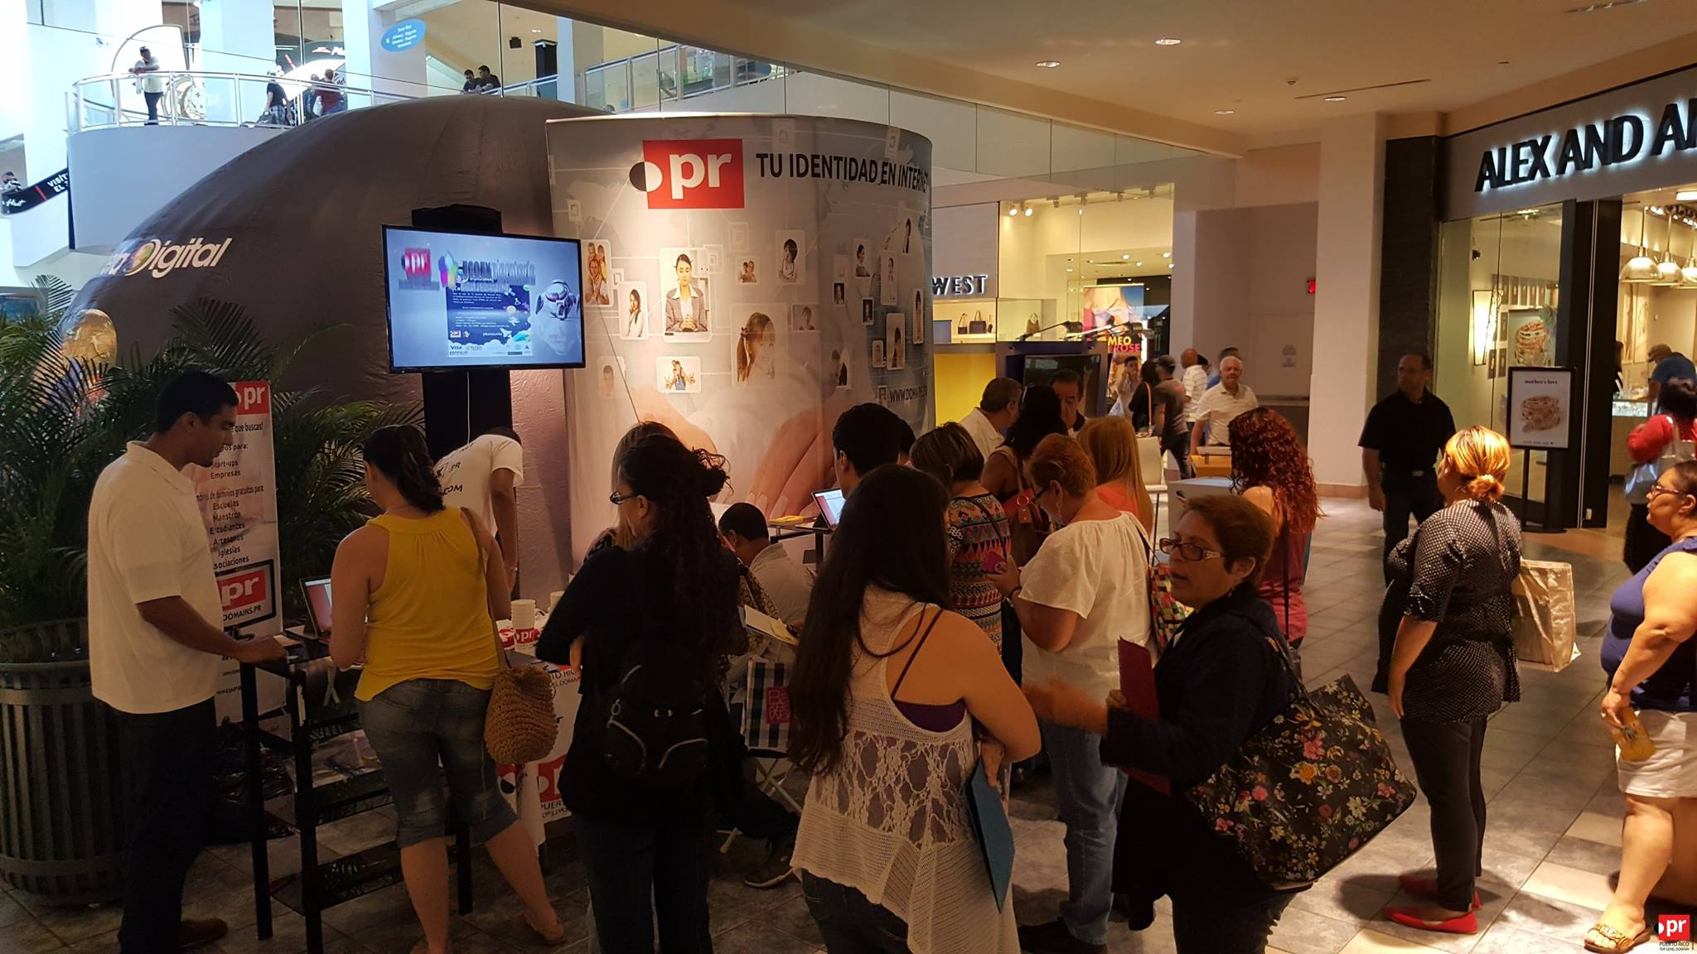

Slide 20
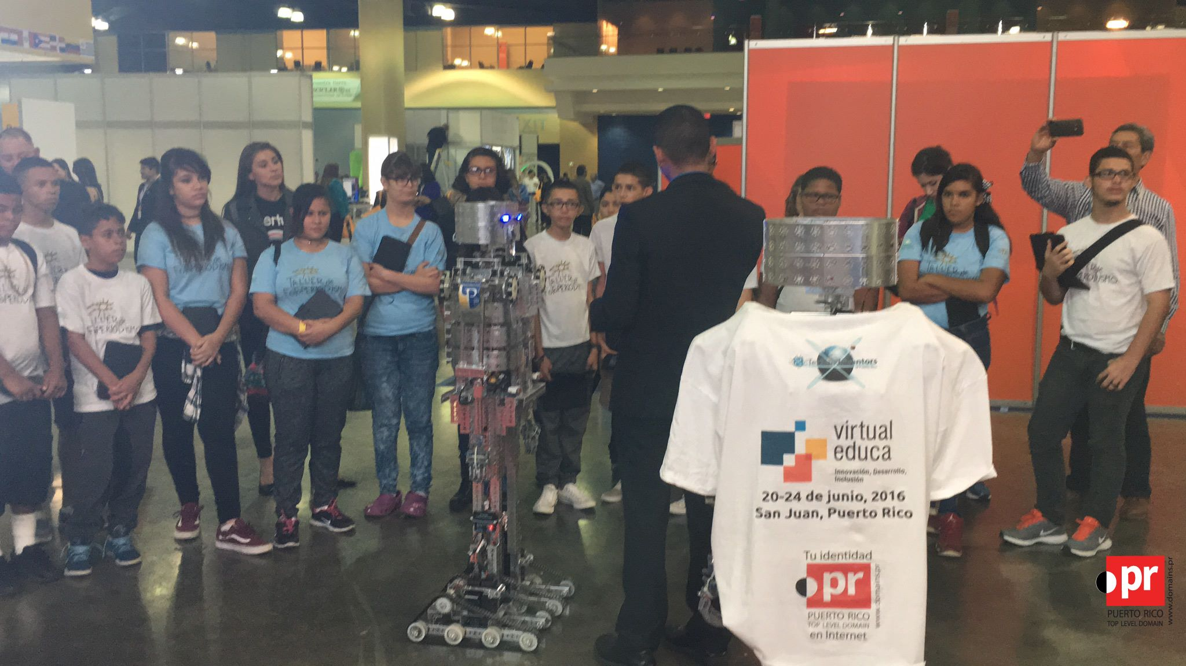

Slide 21
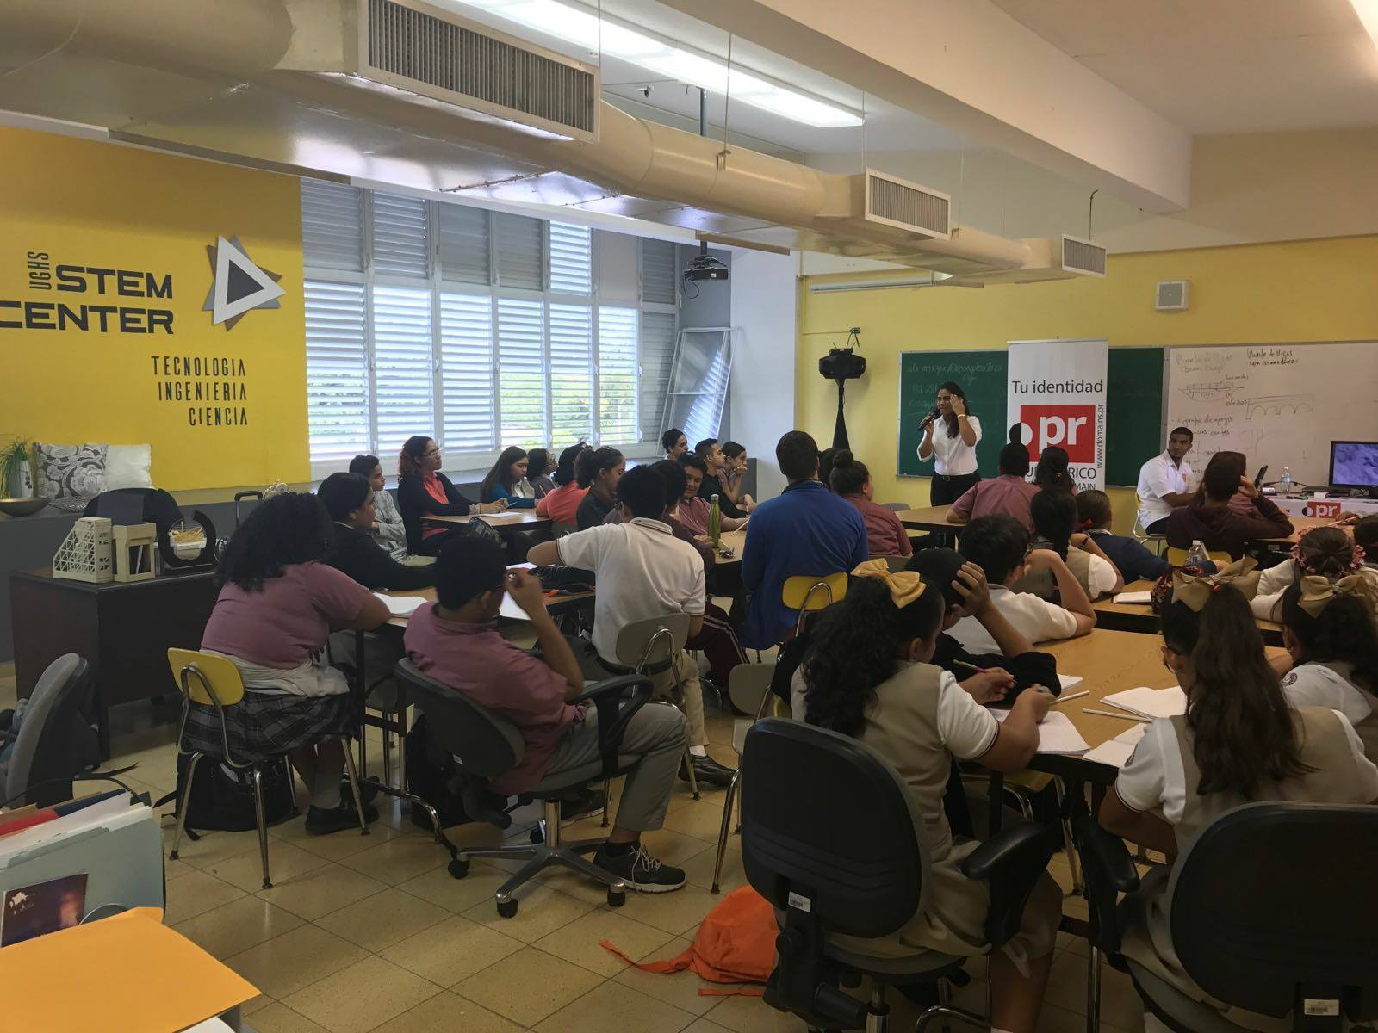

Slide 22
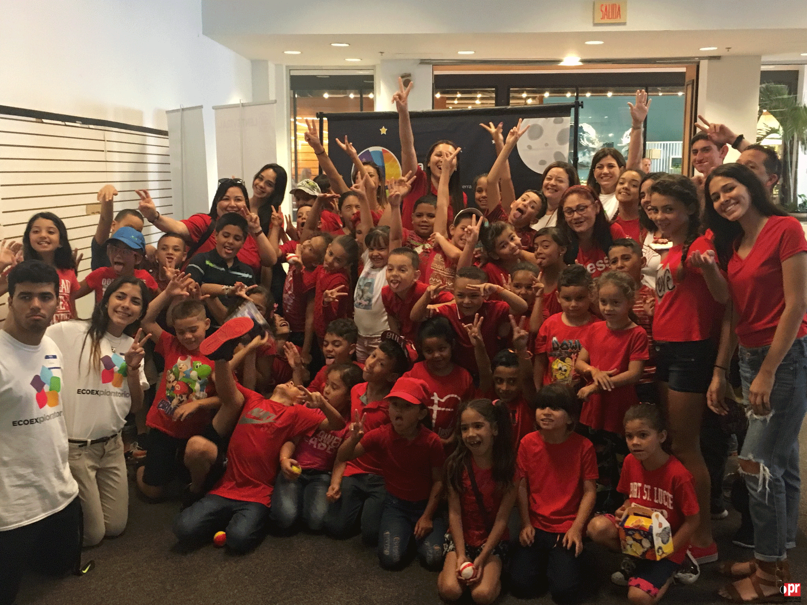

Slide 23
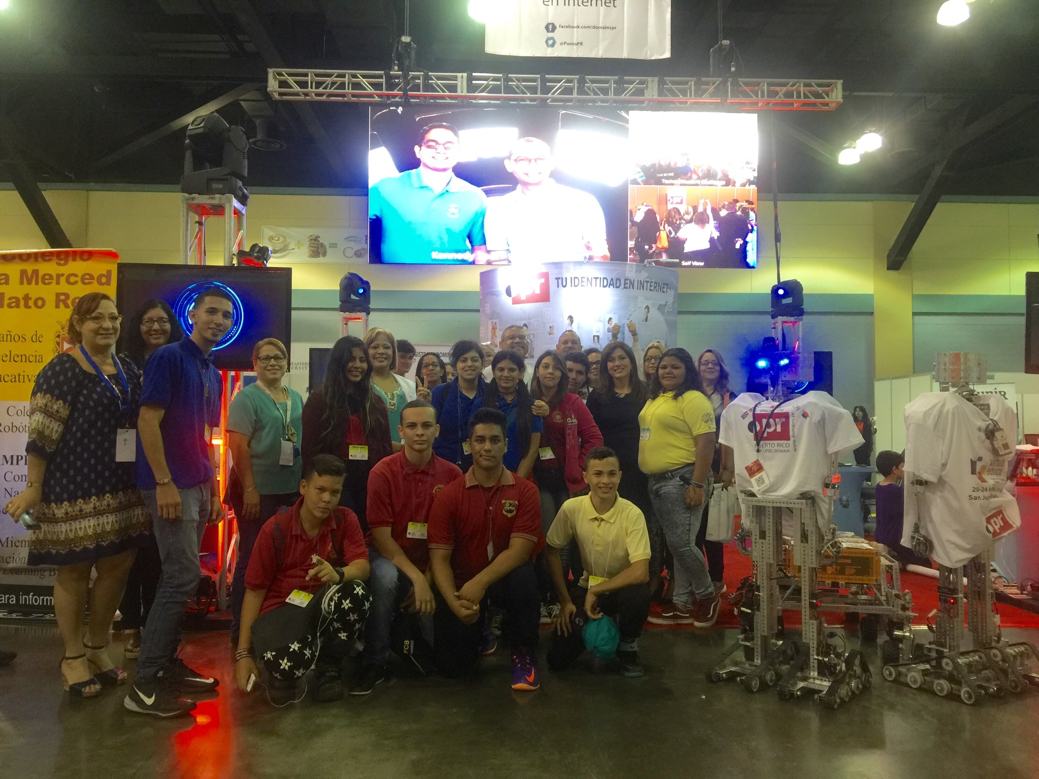

Slide 24
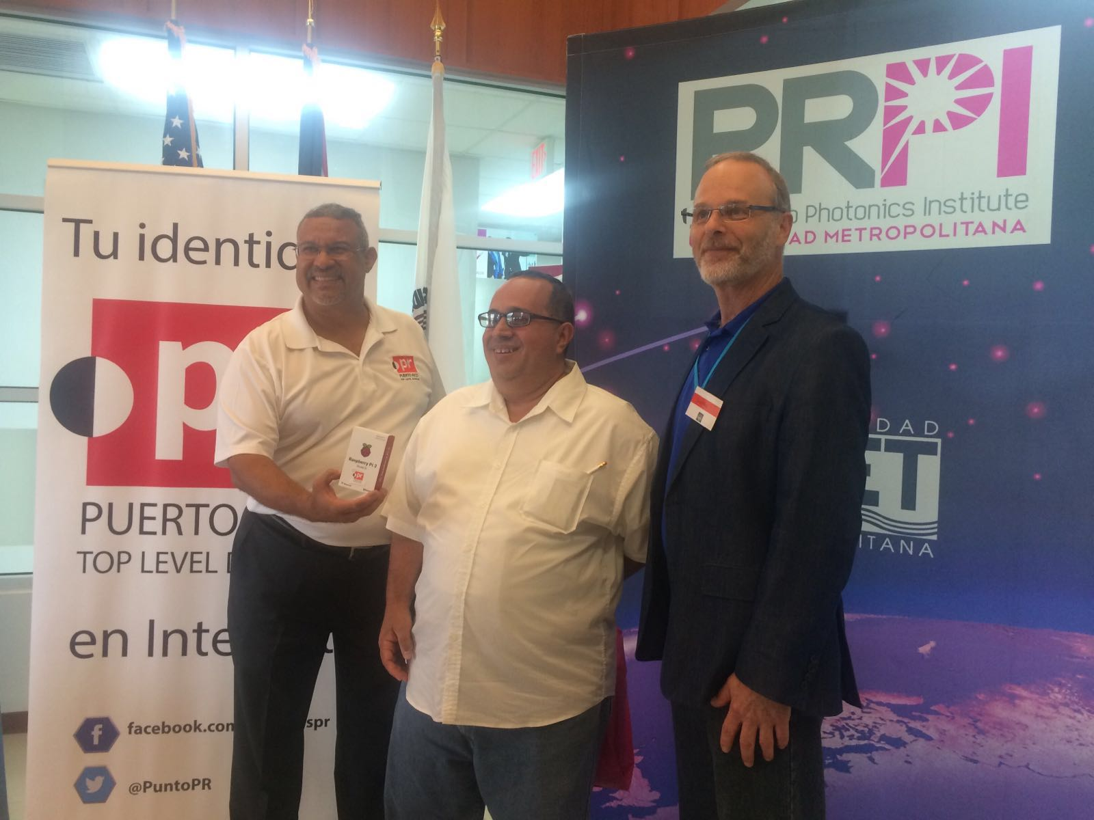

Slide 25
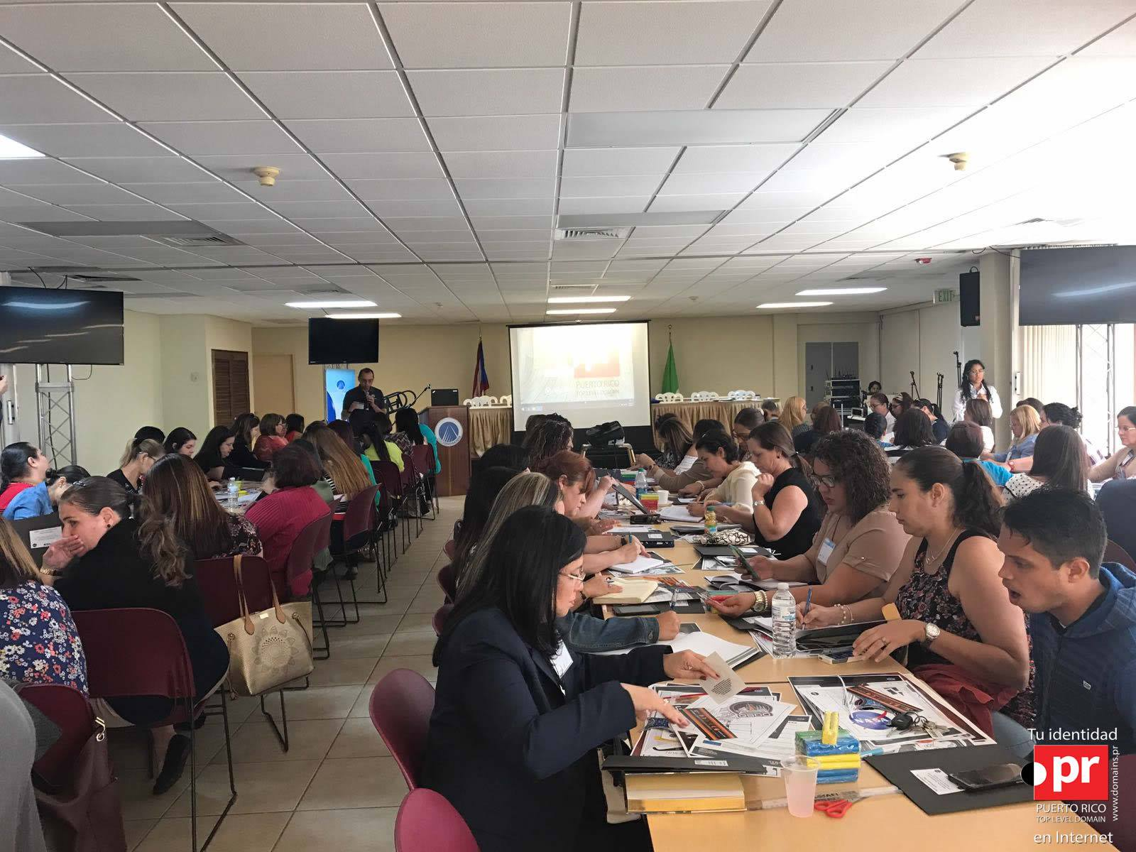

Slide 26
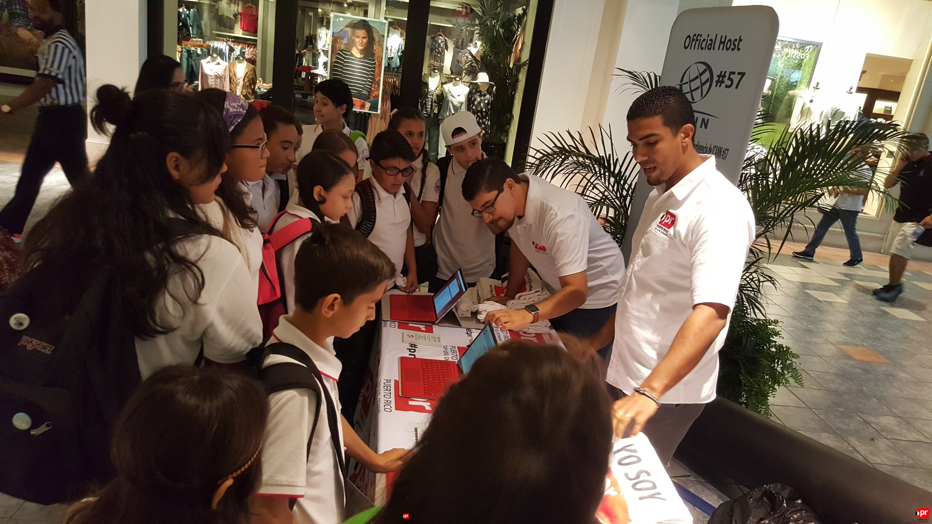

Slide 27
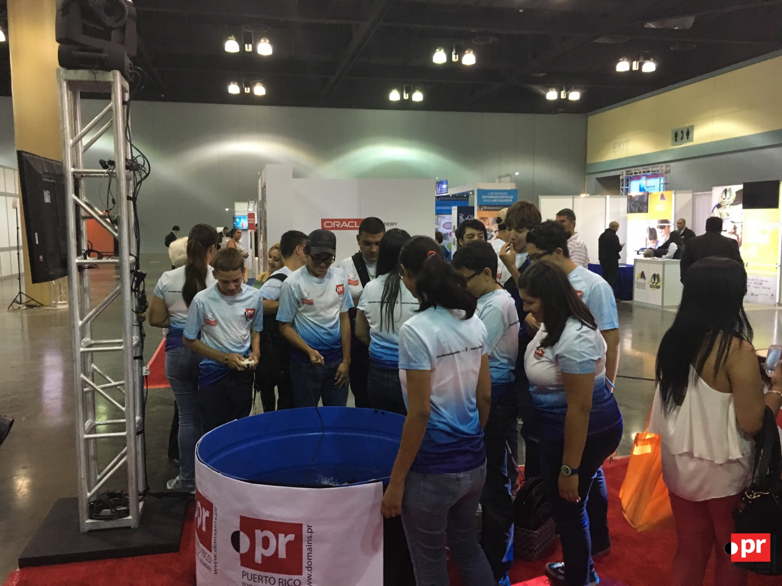

Slide 28
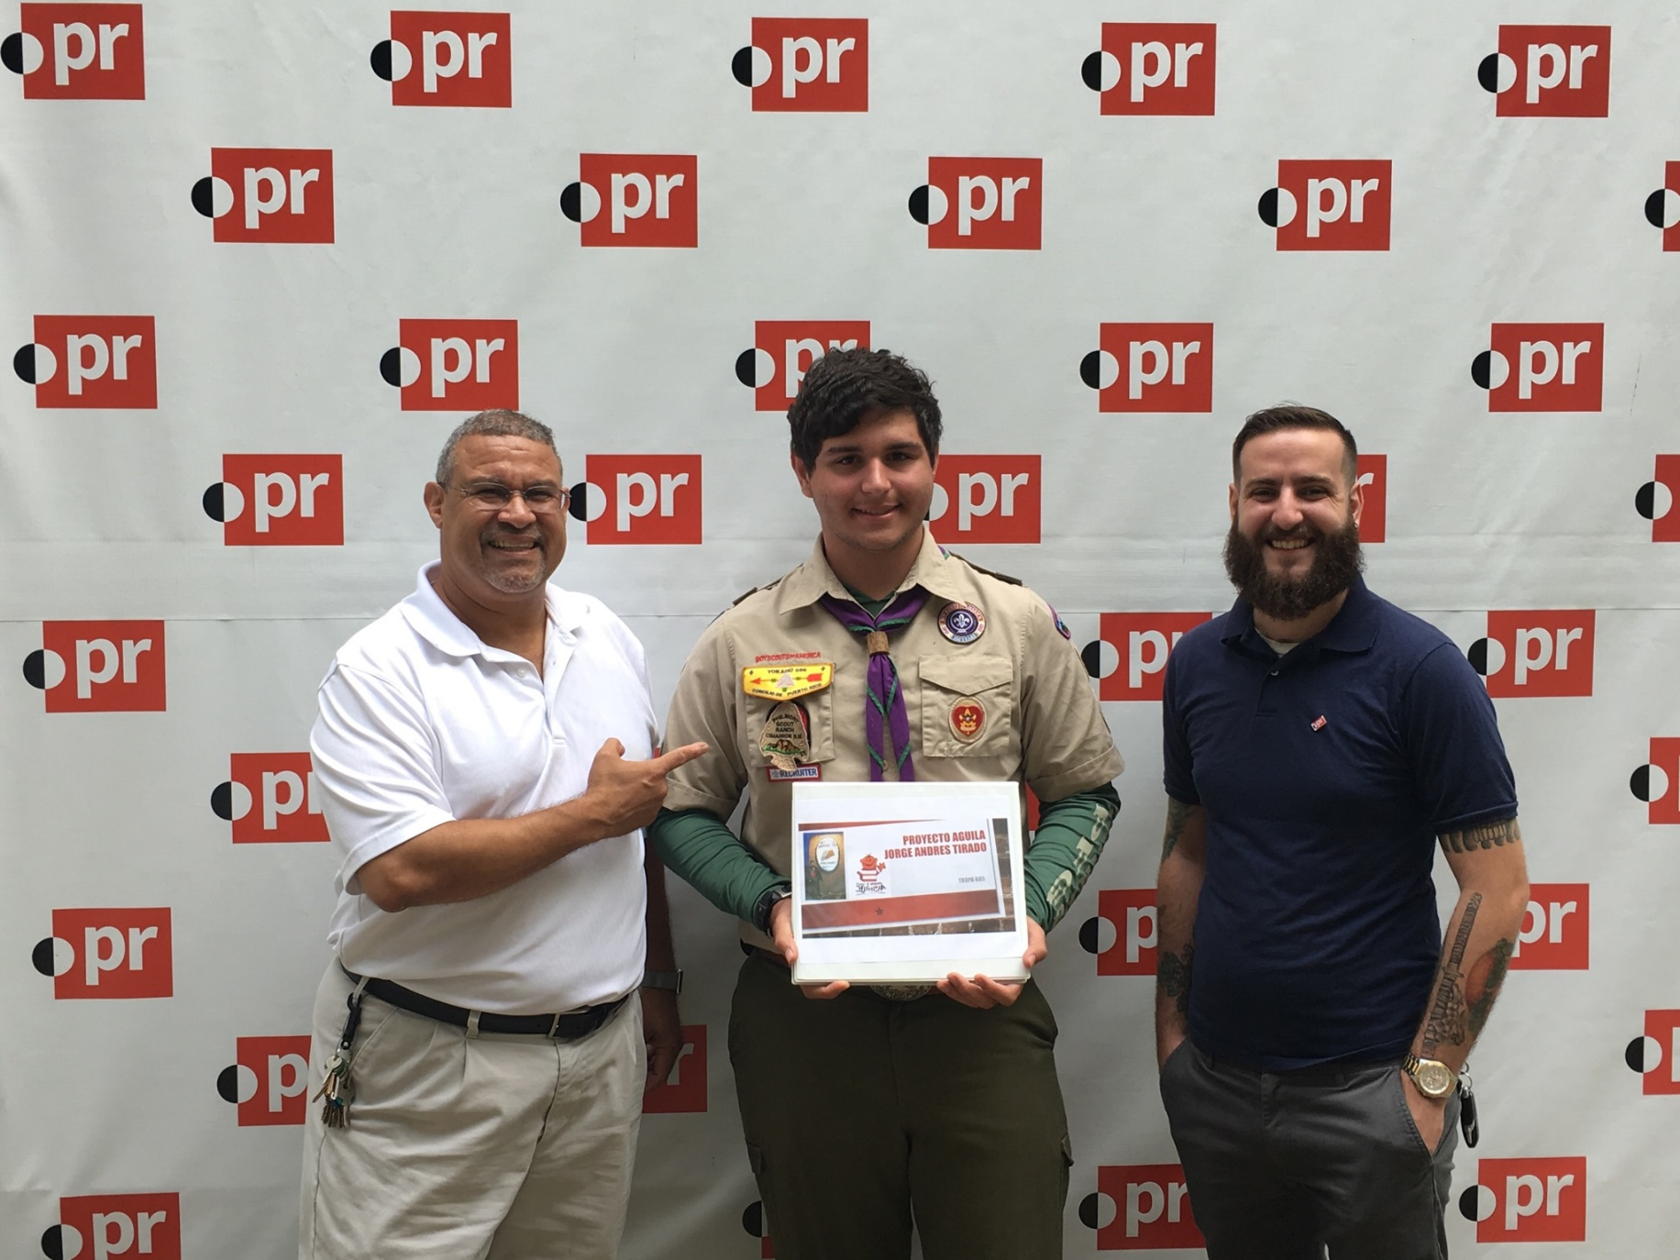

Slide 29
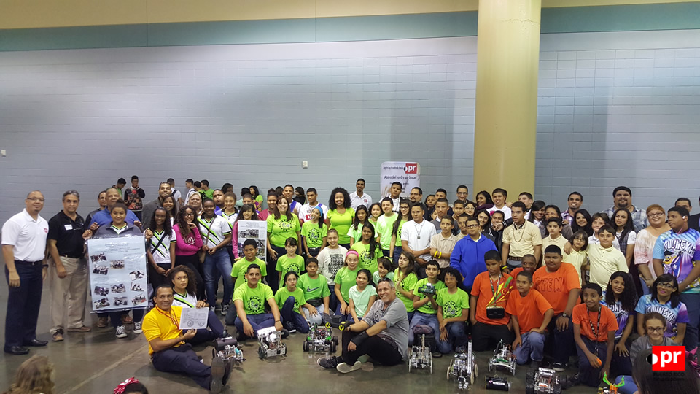

Slide 30
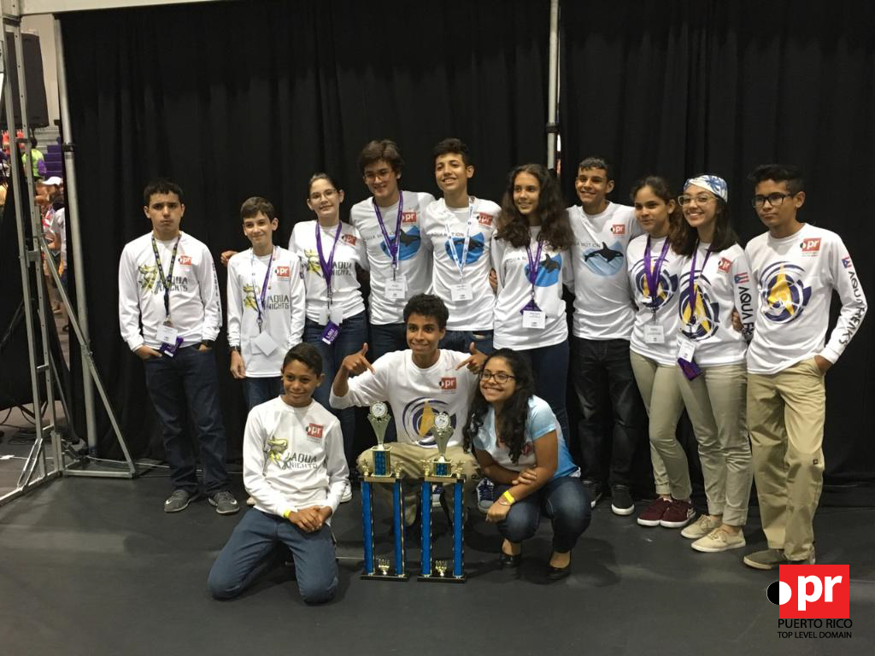

Slide 31
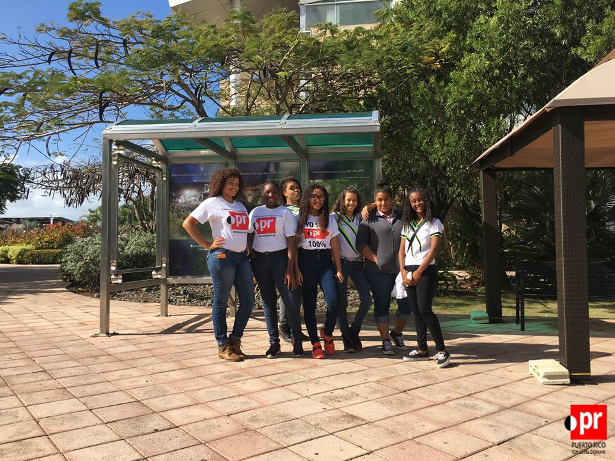

Slide 32
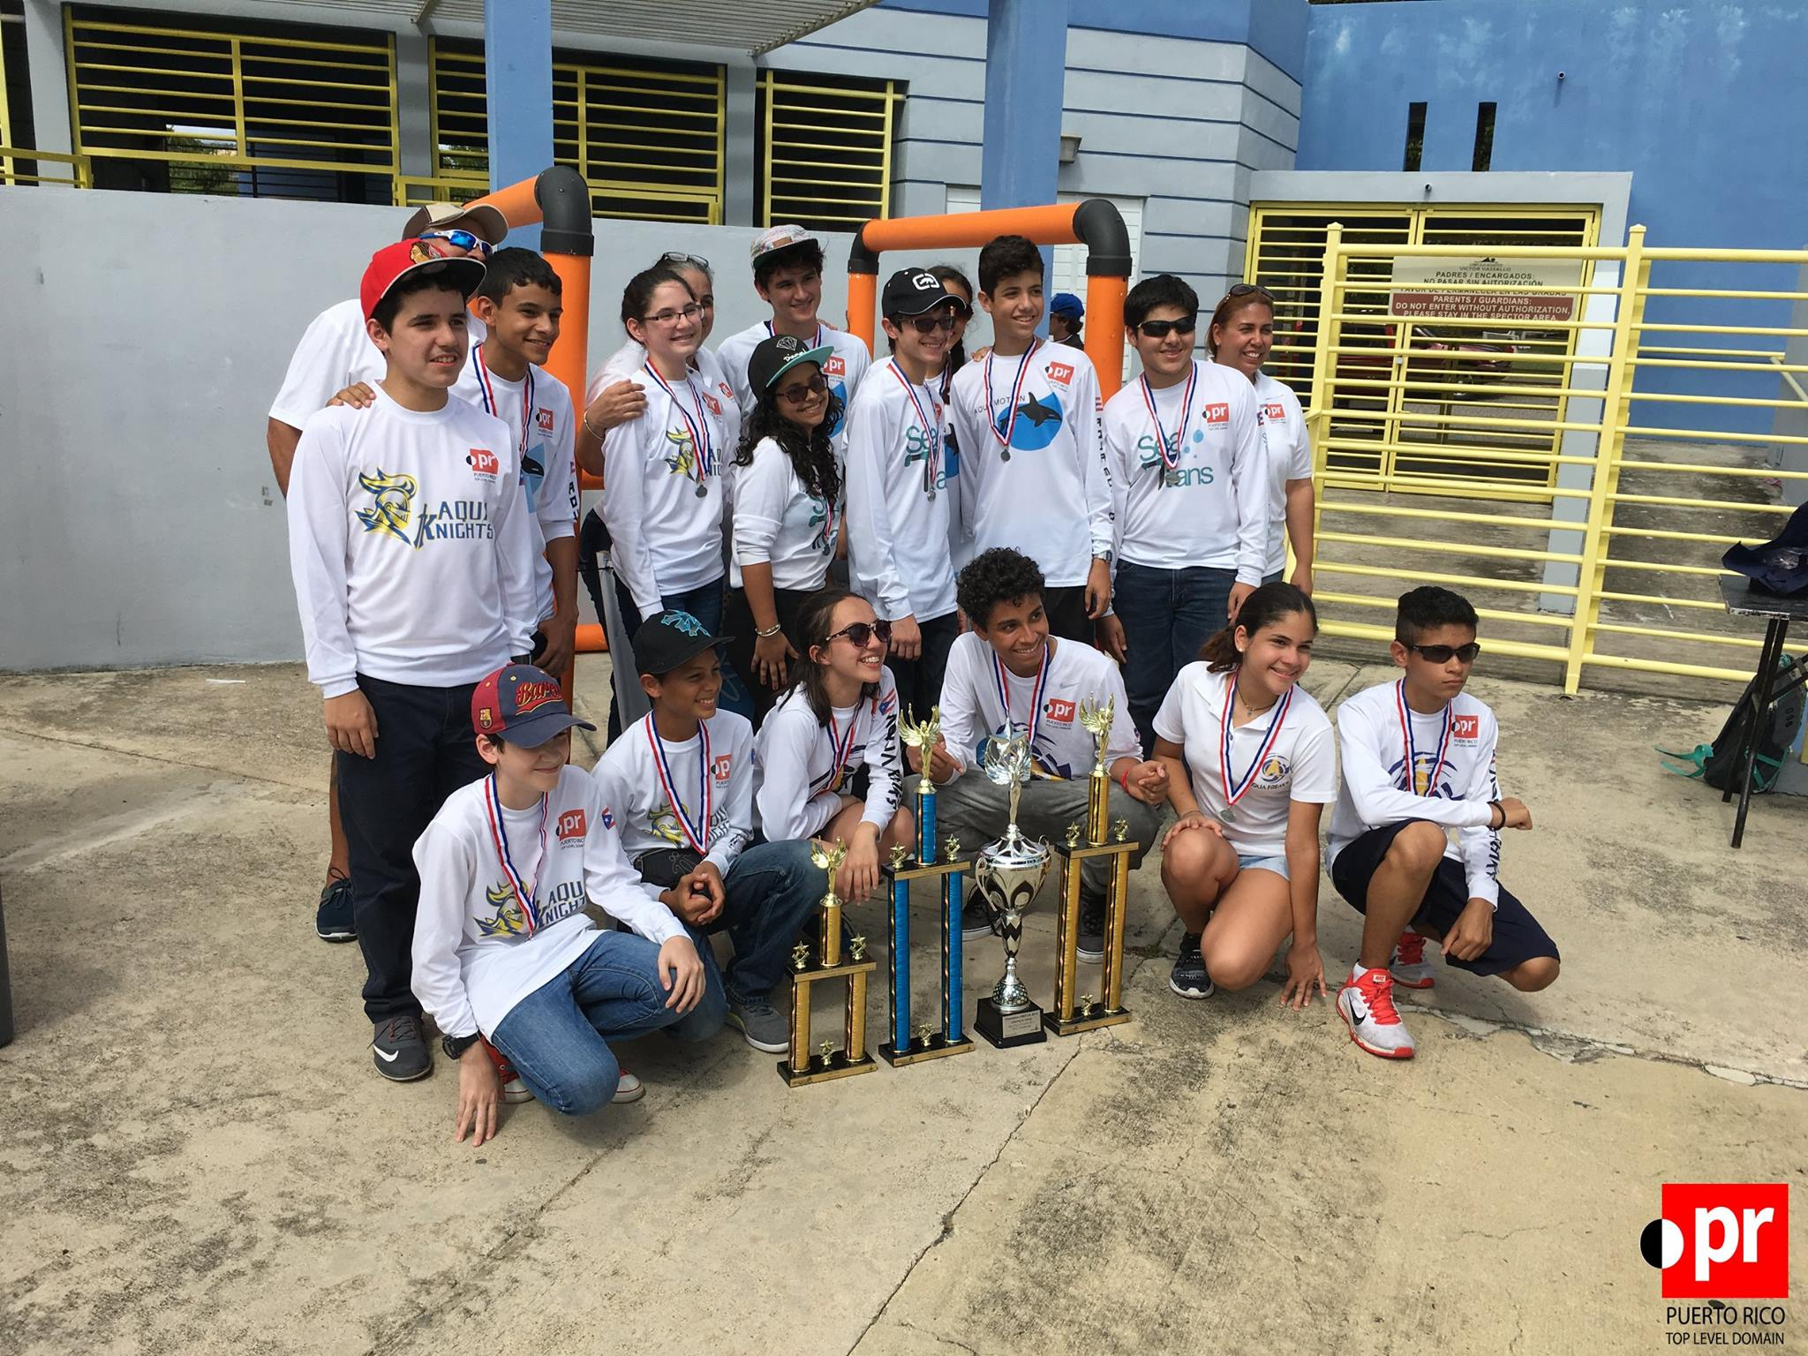

Slide 33
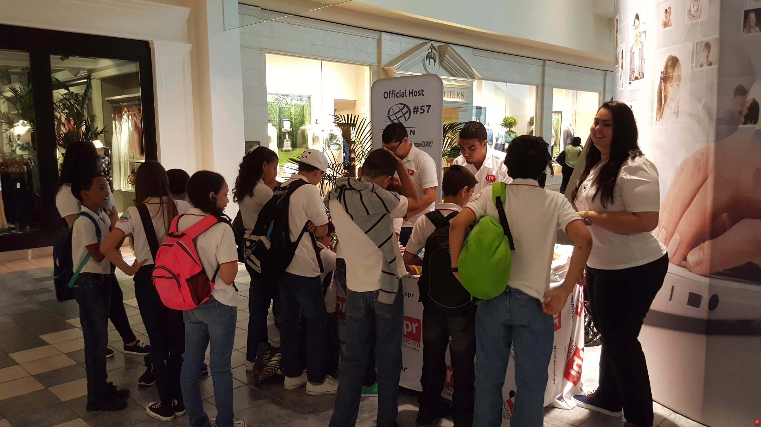

Slide 34
Thank you!

